Slide 1
Lane Detection using color, edge,
and straight line detection
RGB channel, Canny edge, Hough Transform, Ransac
24.03.20
Min-sung Kim /
30242761@edu.hanbat.ac.kr

Slide 2
Contents
1. Color
1.1 Using data
1.2 RGB Channel
1.3 Idea
1.4 Code
1.5 Result
1.6 Problem
Lane Detection
2. Edge
2.1 Canny edge
2.2 Code
2.3 Result
3. Straight line detection
3.1 Hough Transform
3.2 Code
3.3 Result
3.4 Problem
3.5 Ransac
3.6 Code
3.7 Result
3.8 Problem

Slide 3
1. Color
1.1 Using data
1.2 RGB Channel
1.3 Idea
1.4 Code
1.5 Result
1.6 Problem

Slide 4
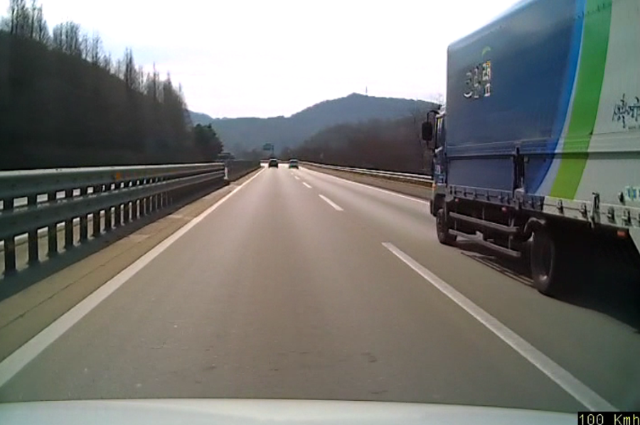
1. Color – 1.1 using data
Lane Detection using color, edge, and straight line detection

Slide 5
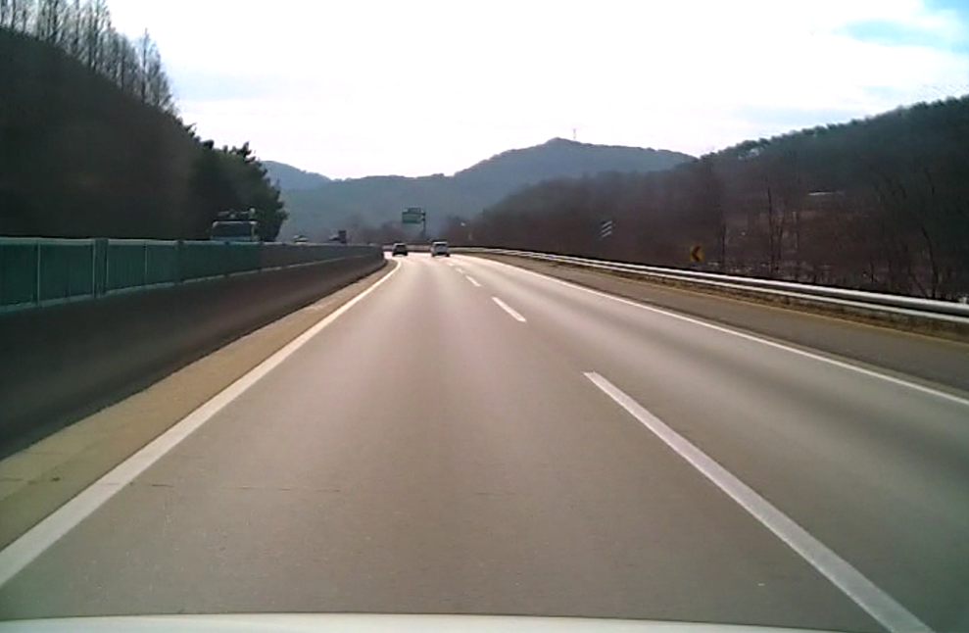
1. Color – 1.1 using data
Lane Detection using color, edge, and straight line detection

Slide 6
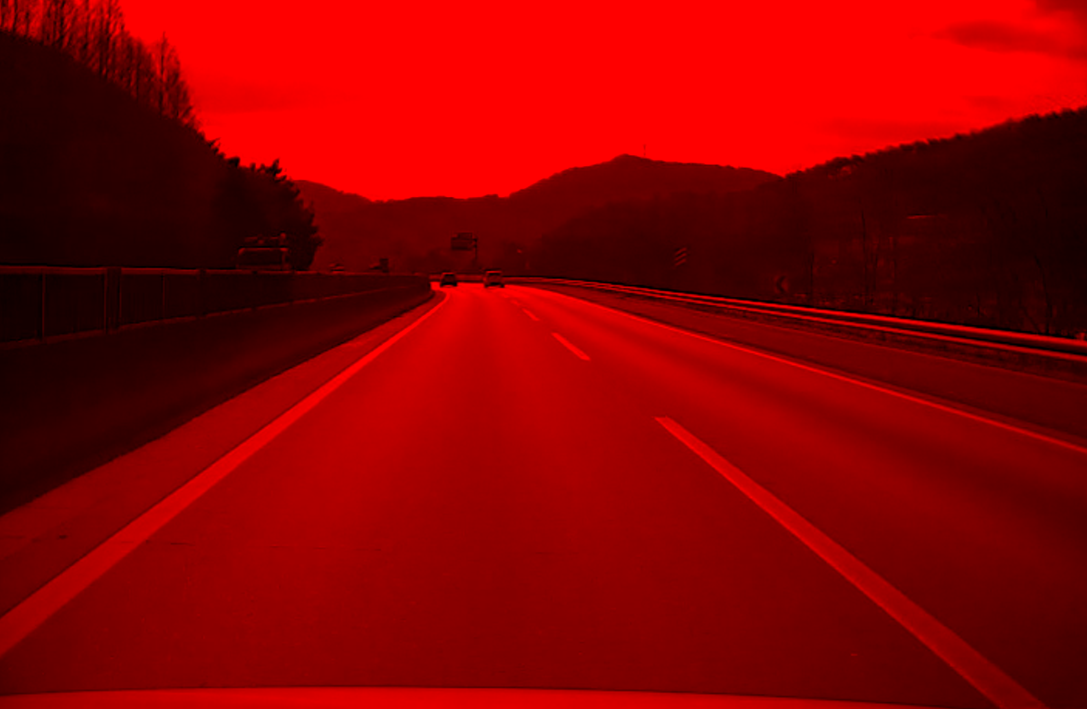
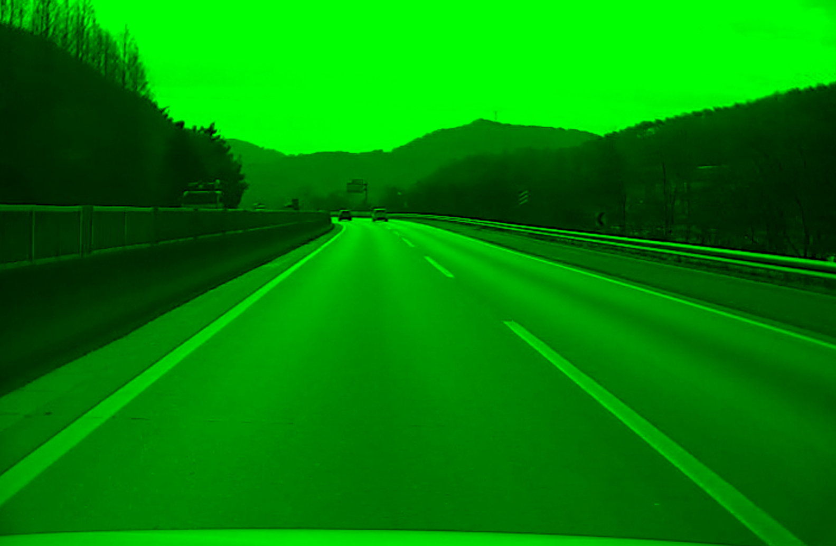
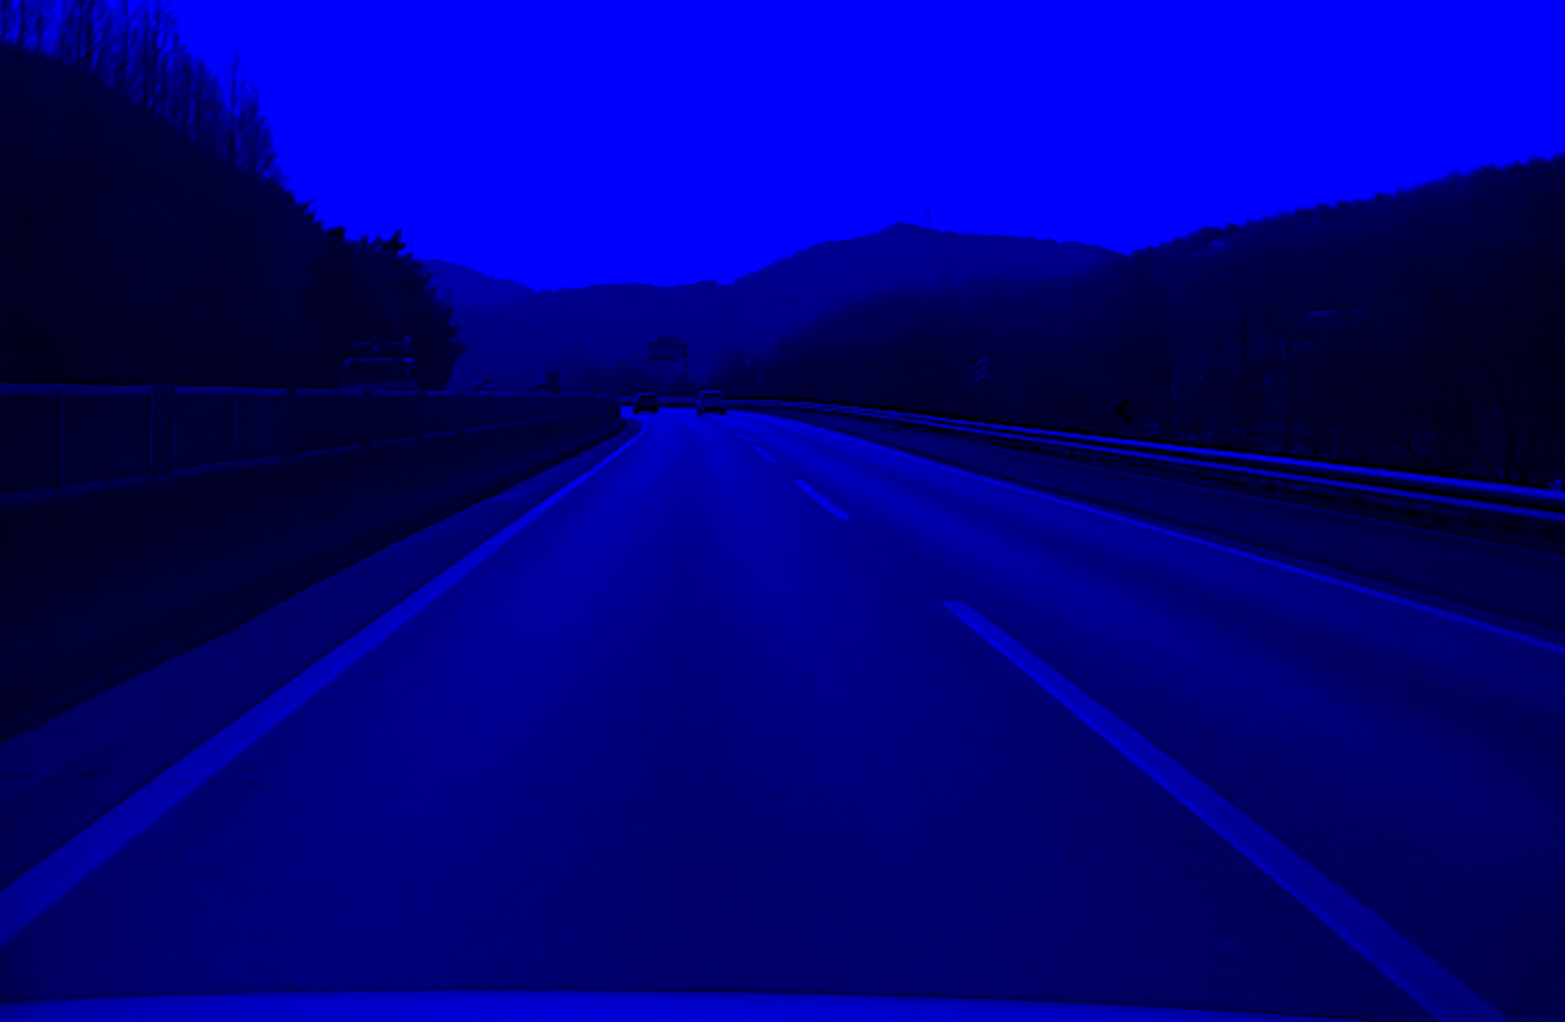
1. Color – 1.2 RGB Channel
Lane Detection using color, edge, and straight line detection
[255, 0, 0]
[0, 255, 0]
[0, 0, 255]
Notes:
컬러 이미지는 보통 3채널에 8비트로 표현이 된다.

Slide 7
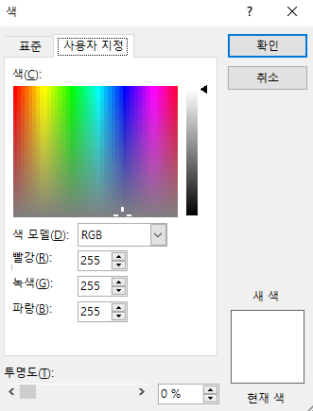
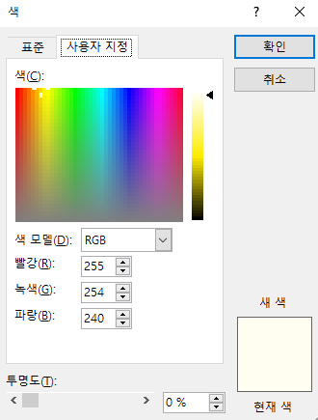
1. Color – 1.3 Idea
Lane Detection using color, edge, and straight line detection

Slide 8
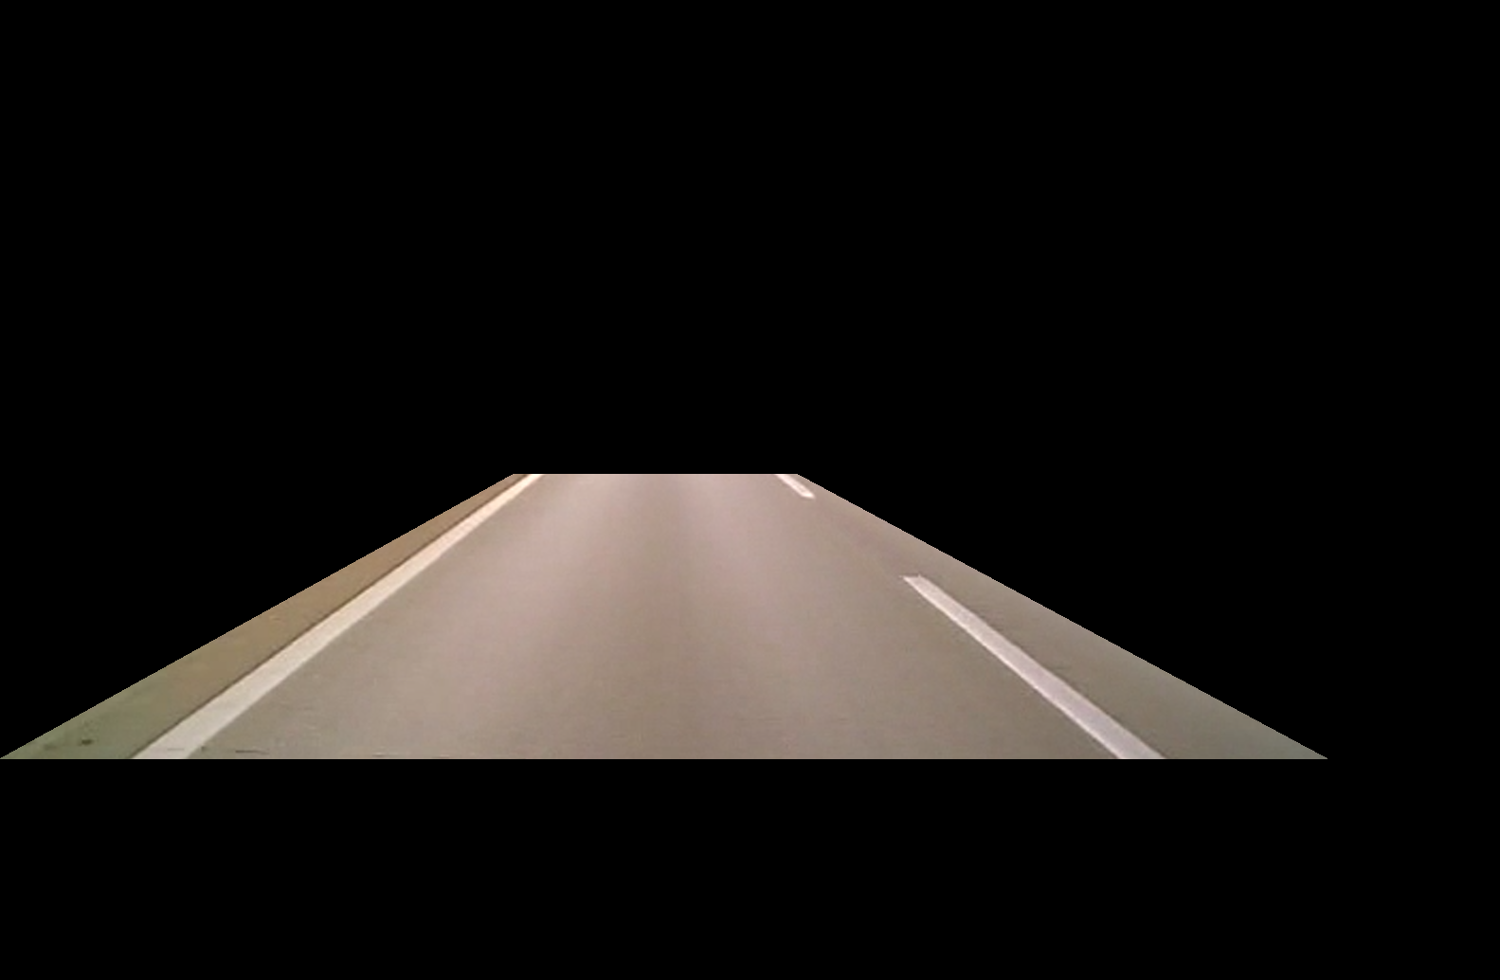
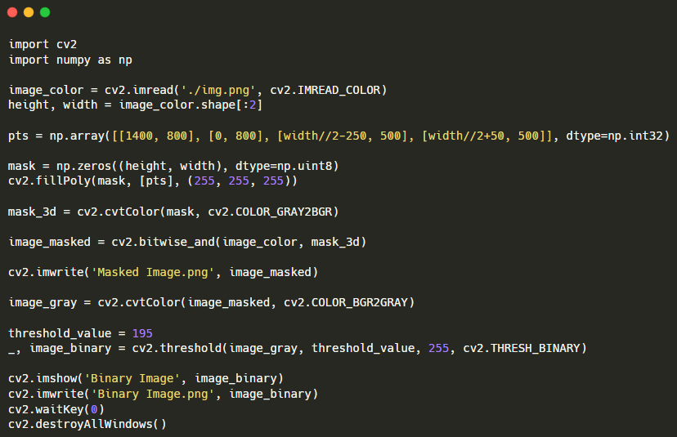
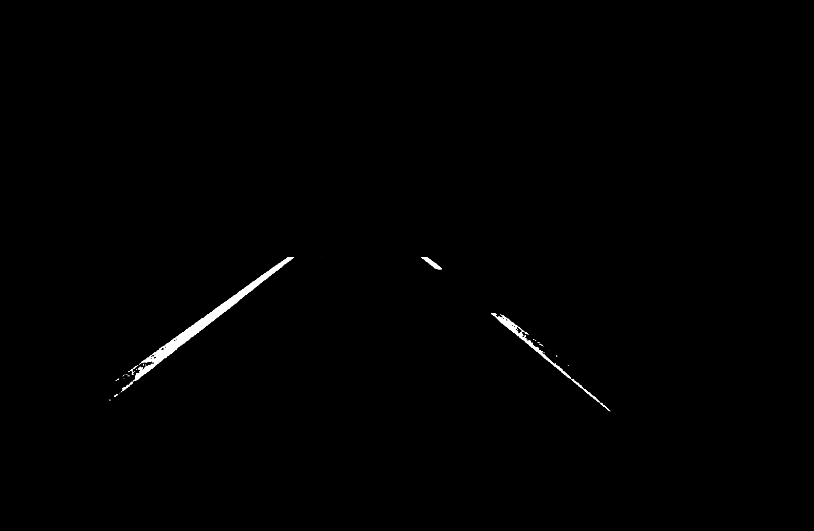
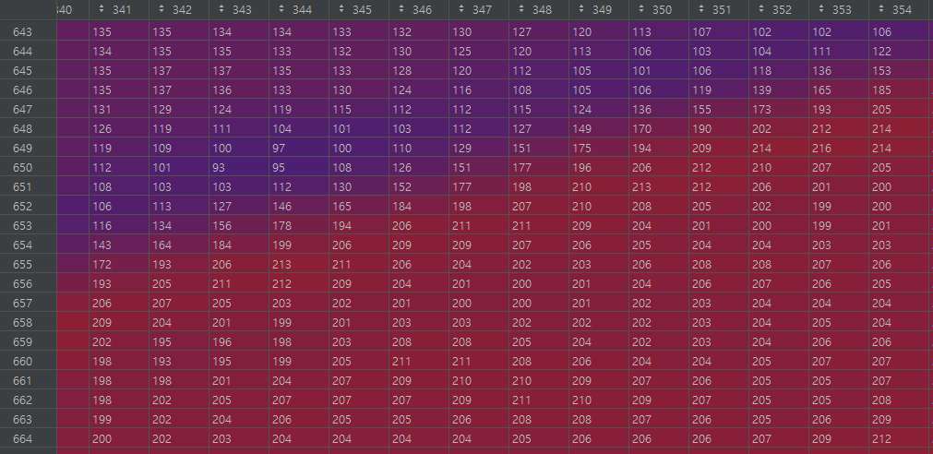
1. Color – 1.4 Code
Lane Detection using color, edge, and straight line detection
[ Width//2-250, 500 ]
[ Width//2+50, 500 ]
[ 0, 800 ]
[ 1400, 800 ]
※ image resolution : [ 1583, 1034 ]
※ Part of the image_gray…

Slide 9
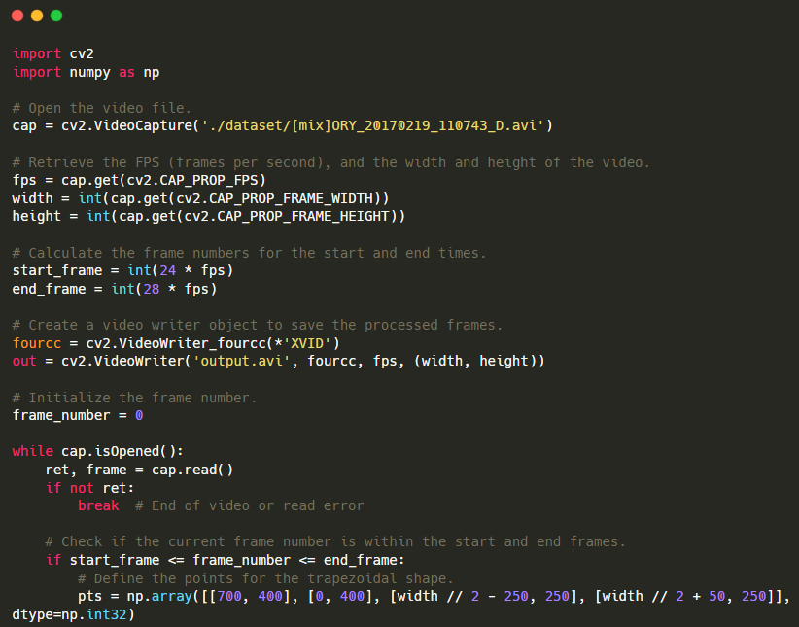
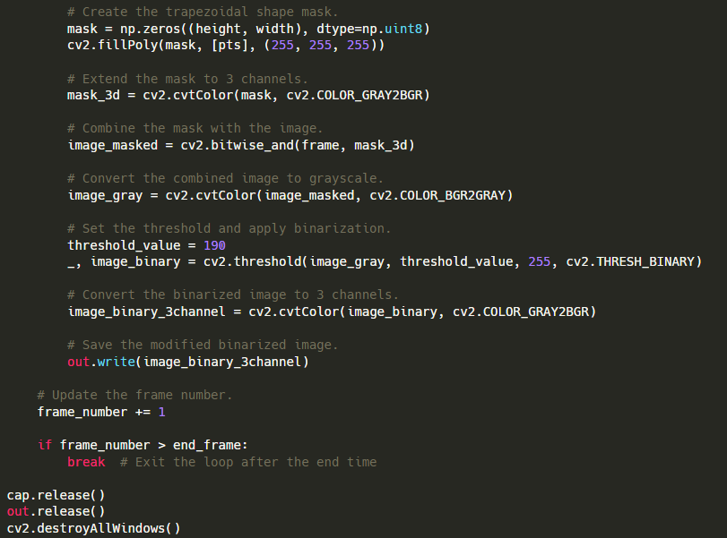
1. Color – 1.4 Code
Lane Detection using color, edge, and straight line detection

Slide 10
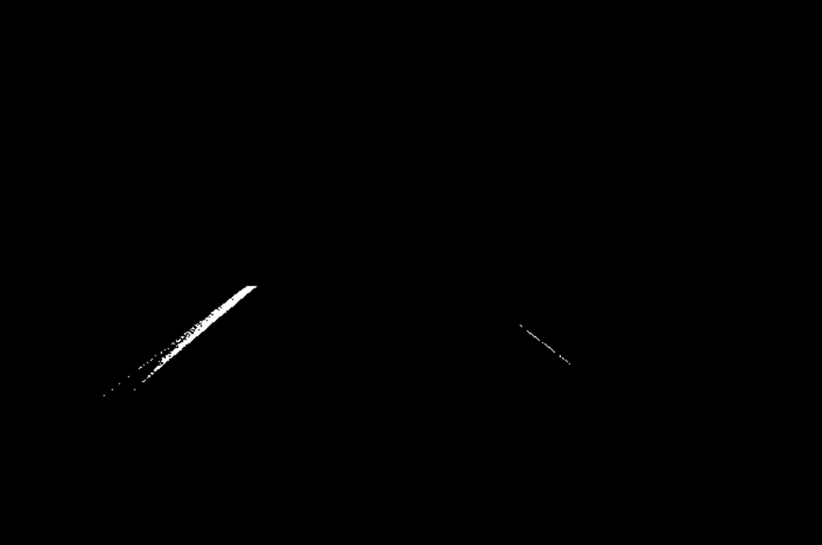
1. Color – 1.5 Result
Lane Detection using color, edge, and straight line detection

Slide 11
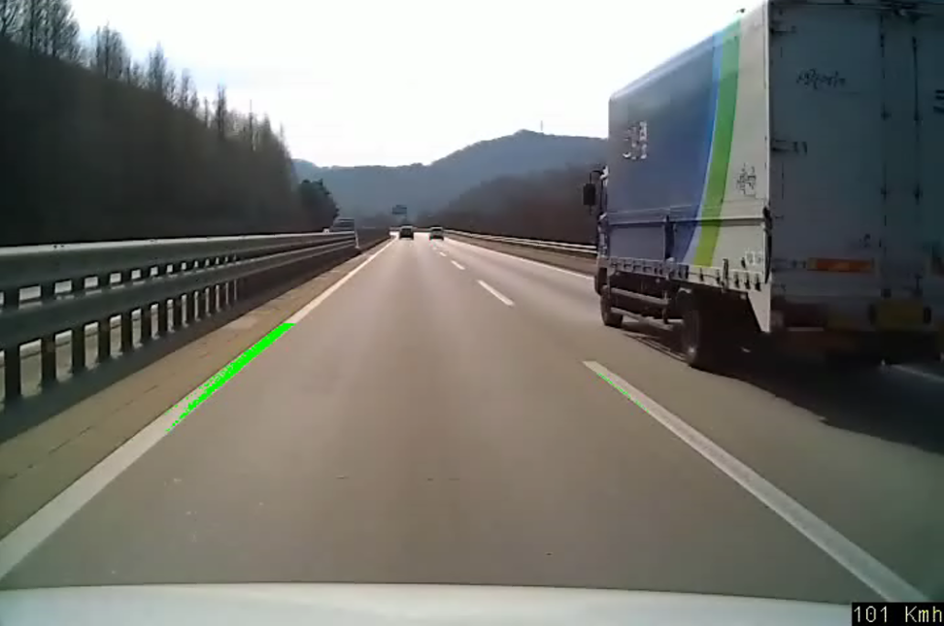
1. Color – 1.5 Result
Lane Detection using color, edge, and straight line detection

Slide 12
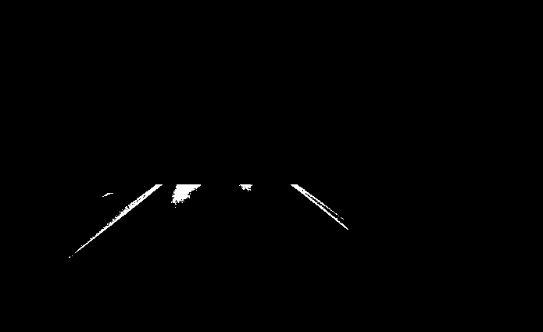
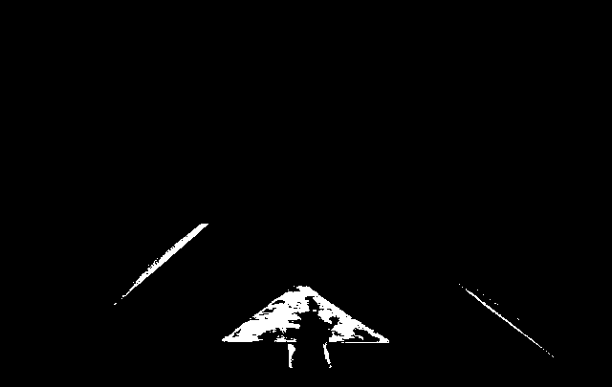
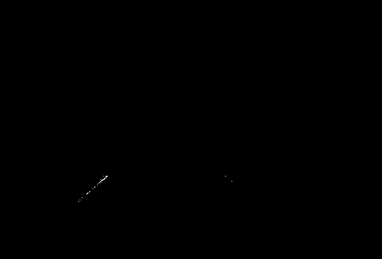
1. Color – 1.6 Problem
Lane Detection using color, edge, and straight line detection
Bright conditions
Other sign
Illumination
Bright conditions
Dark copnditions
Other sign
Unclear line
3 problem
So, Use the Canny Edge Algorithm and consider only straight lines
Dark conditions
Notes:
픽셀값이 다 다르기에 경계선을 검출하고 검출된 경계선에서 직선만을 고려하도록 하면 차선을 더 잘 detection할 것 같음

Slide 13
2. Edge
2.1 Canny edge
2.2 Code
2.3 Result

Slide 14
2. Edge – 2.1 Canny edge
Lane Detection using color, edge, and straight line detection
< Canny Edge Algorithm>
■ Exaplain
The Canny Edge Detection Algorithm, proposed by John Canny in 1986, is considered the most superior among edge detectors discussed to date.
■ 3 Goal
Minimize Noise
1. Good detection
2. Good localization
3. Only one response to a single edge
■ HOW?
2 | 2 | 2 | 6 | 6 | 6 | 6
Gaussian Filtering
Sobel Filtering
Non-Maximum Suppression
Hysteresis Edge tracking
Stair Edge
Edge
2 | 2 | 2 | 4 | 6 | 6 | 6
Ramp Edge

Slide 15
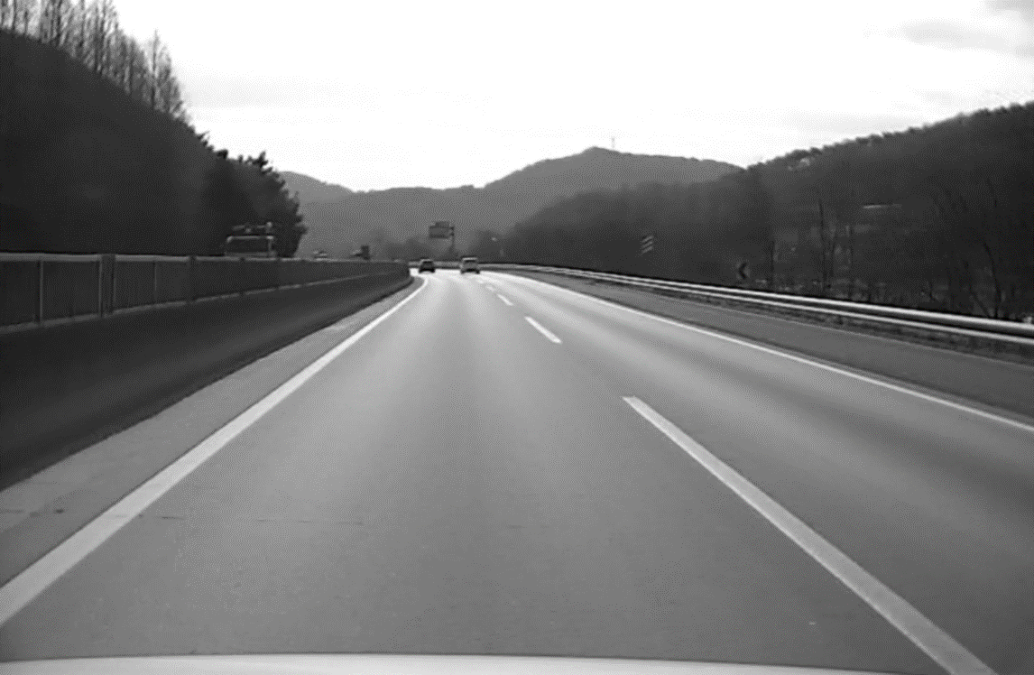
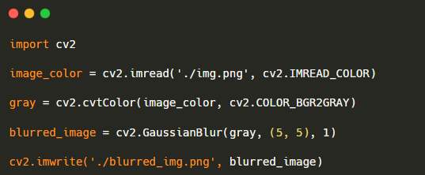

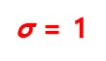

2. Edge – 2.2 Code
Lane Detection using color, edge, and straight line detection
Gaussian Filtering
$\text{σ}$↑
Ex)
…
$\text{σ}$ = 1
$\text{σ}$ = 2
ㅍ
ㅍ
0.0751 | 0.1238 | 0.0751
0.1238 | 0.2042 | 0.1238
0.0751 | 0.1238 | 0.0751
0.1019 | 0.1154 | 0.1019
0.1154 | 0.1308 | 0.1154
0.1019 | 0.1154 | 0.1019

Slide 16
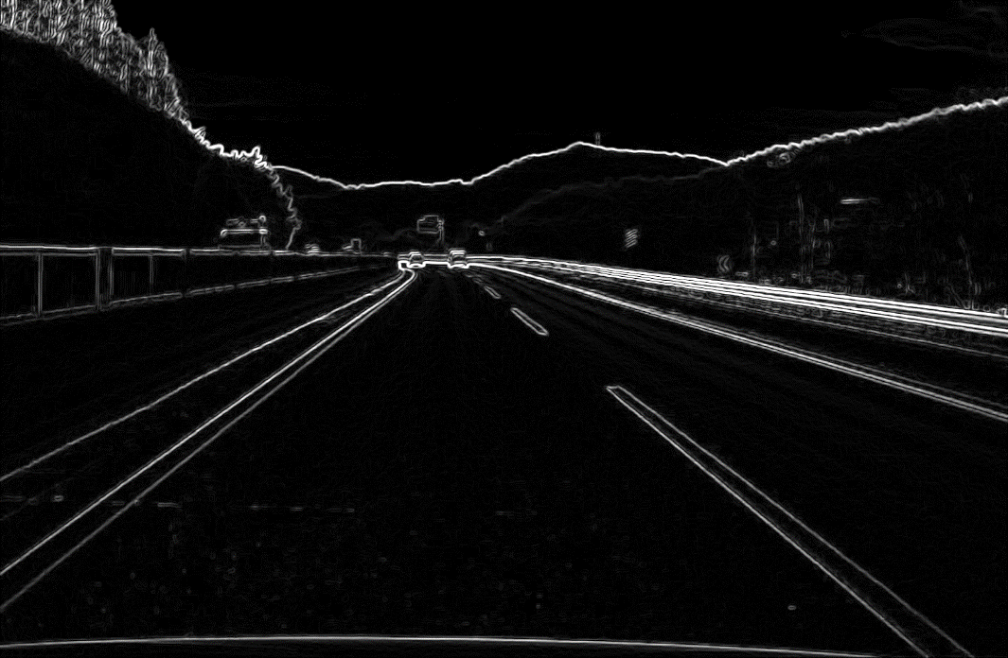
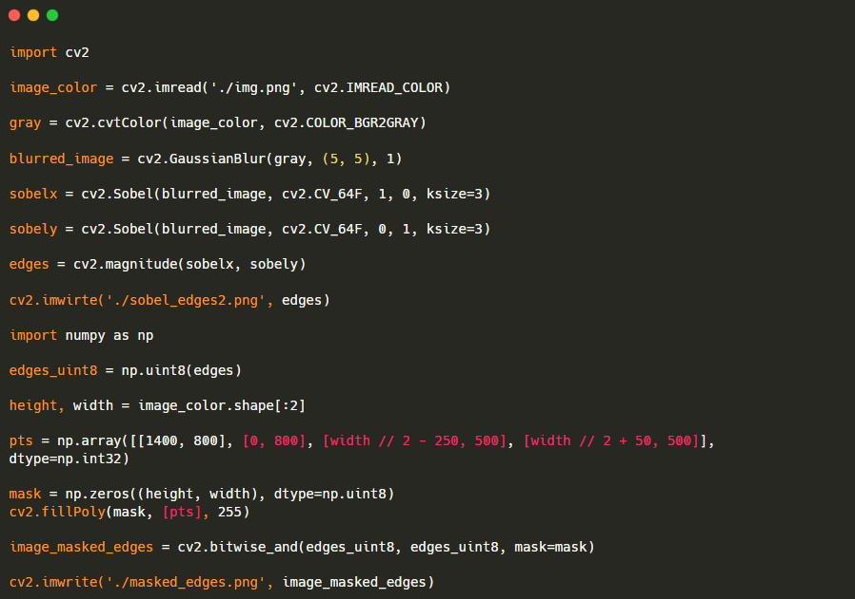
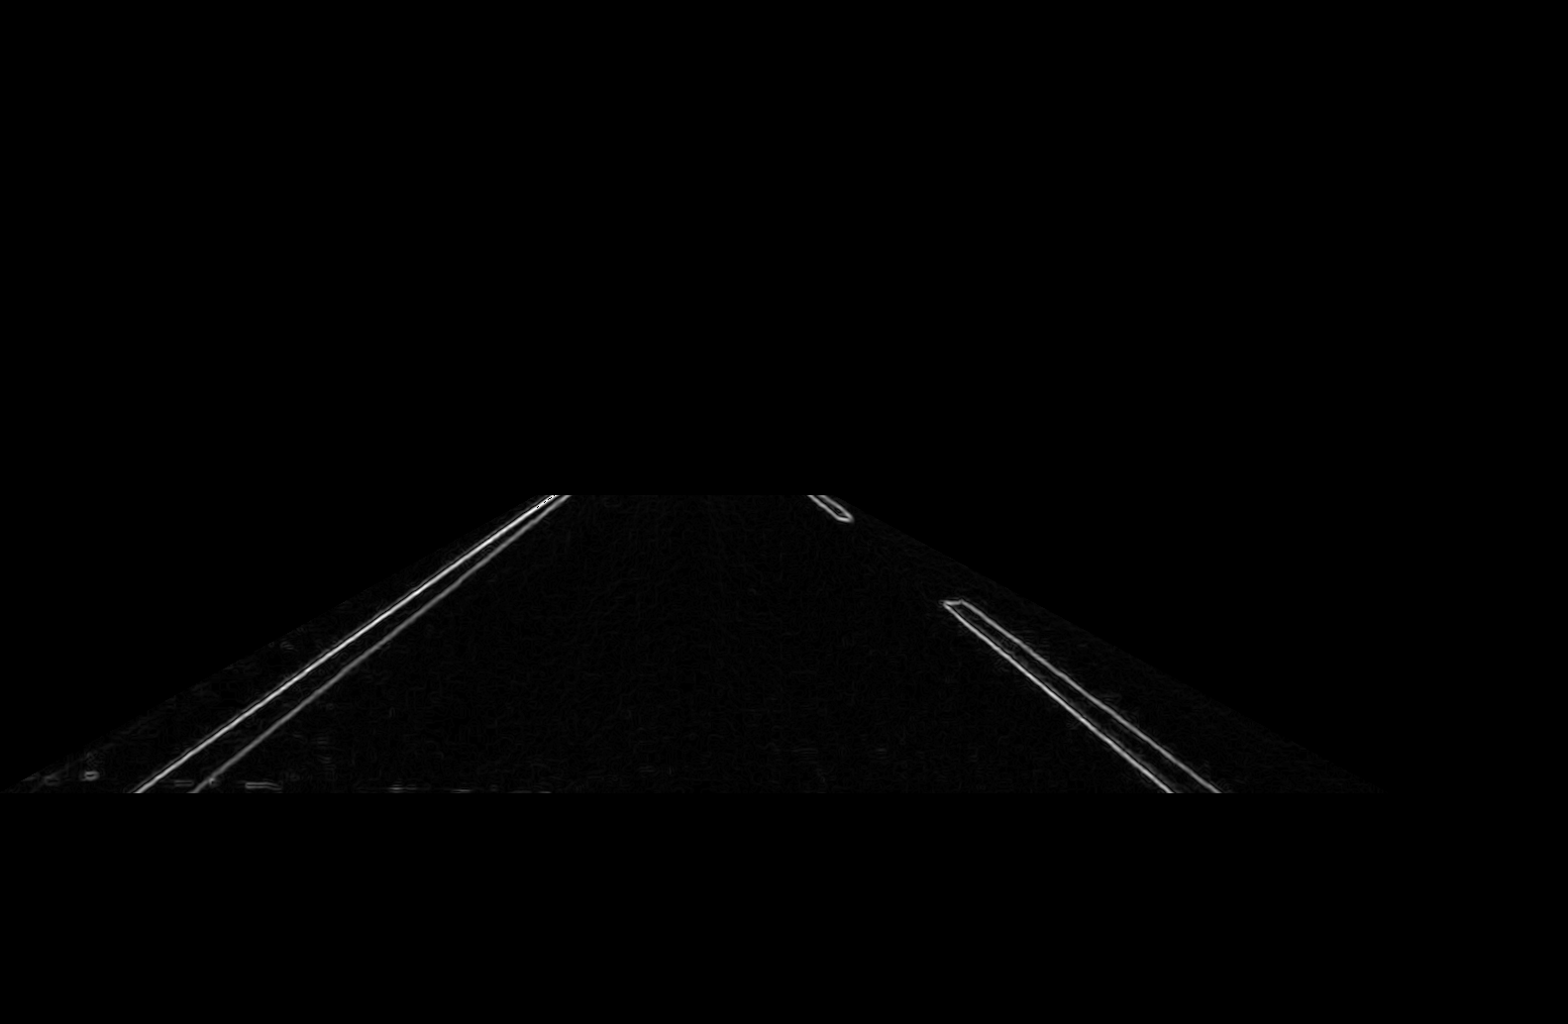



2. Edge – 2.2 Code
Lane Detection using color, edge, and straight line detection
2. Sobel Filtering
Sobel Filter
-1 |  | 1
-2 |  | 2
-1 |  | 1
$$u_{x}=$$
-1 | -2 | -1
1 | 2 | 1
$$u_{y}=$$
pts

Slide 17
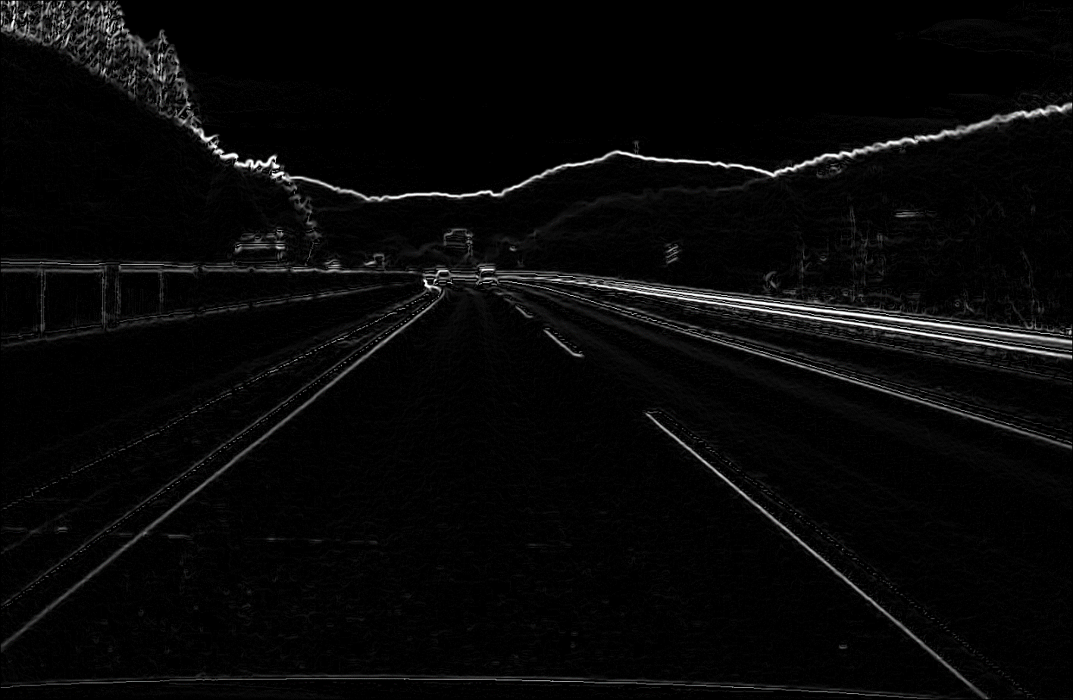
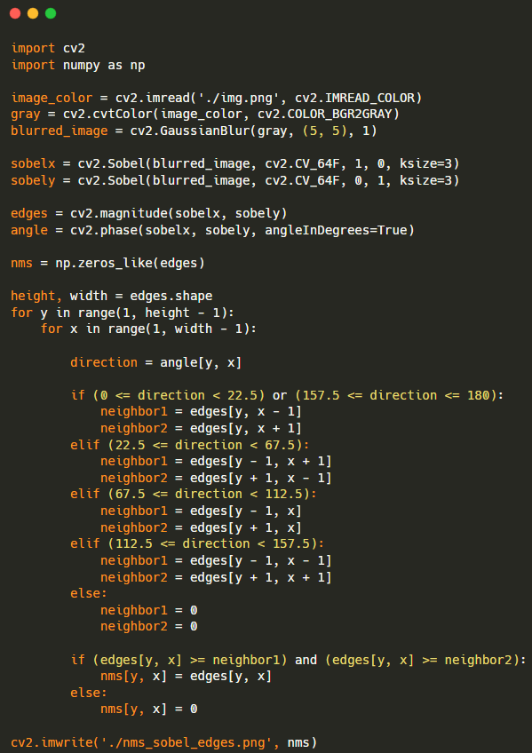
2. Edge – 2.2 Code
Lane Detection using color, edge, and straight line detection
3. Non-Maximum Suppression

Slide 18
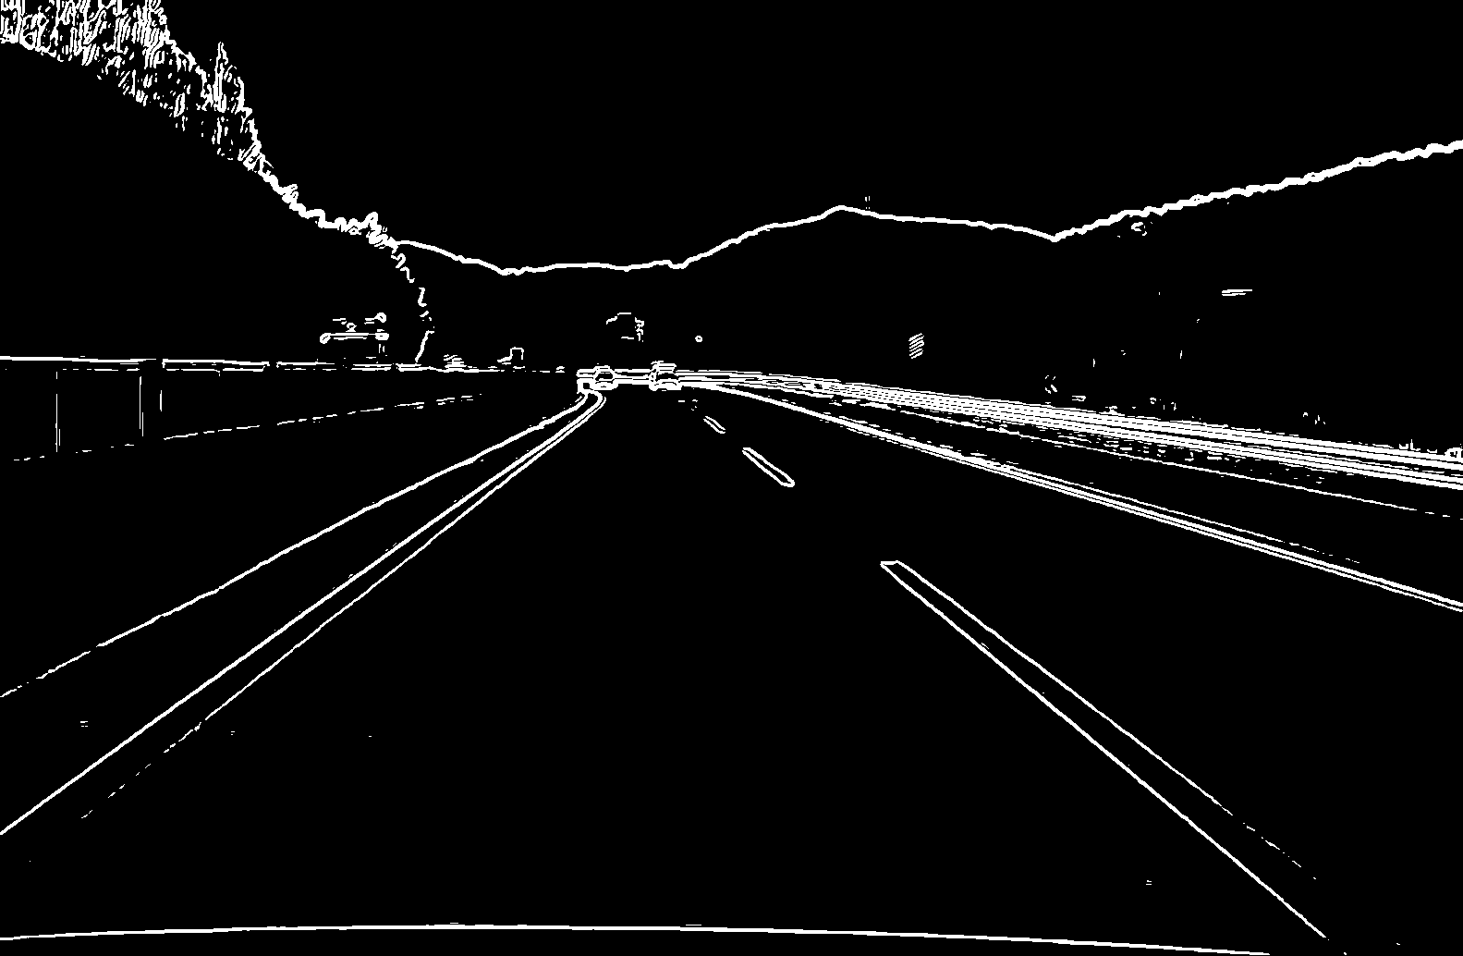
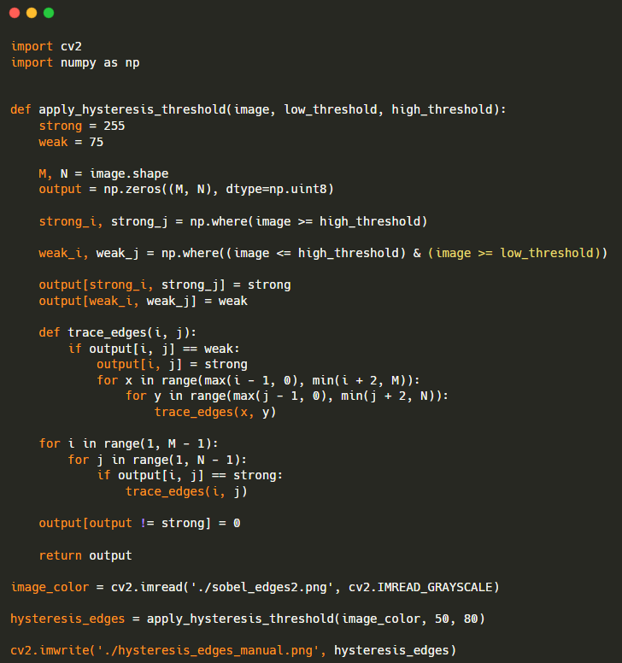

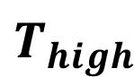
2. Edge – 2.2 Code
Lane Detection using color, edge, and straight line detection
4. Hysteresis Edge tracking
$$T_{high}$$
$$T_{Low}$$

Slide 19
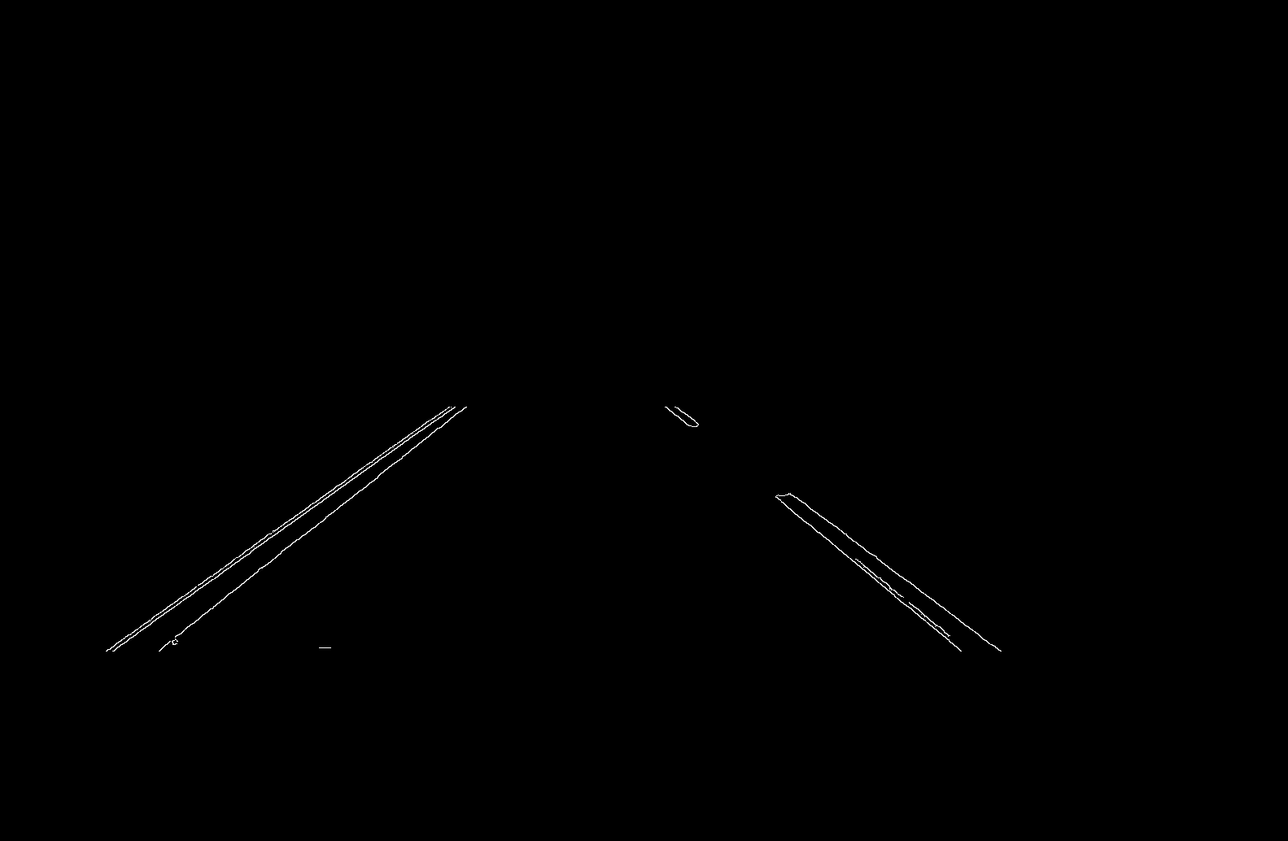
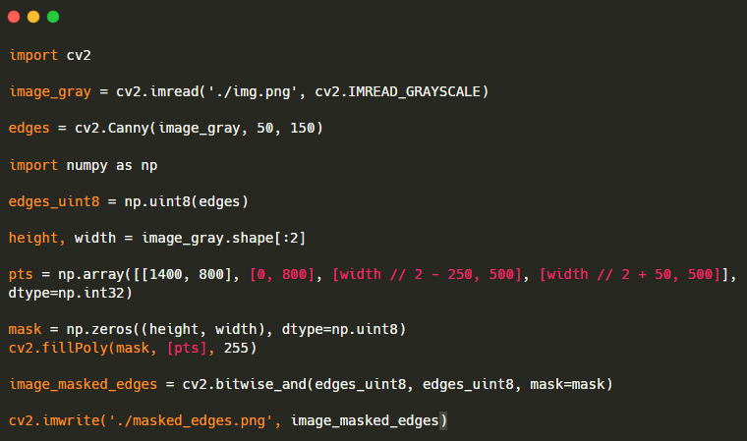
2. Edge – 2.2 Code
Lane Detection using color, edge, and straight line detection
Canny Edge

Slide 20
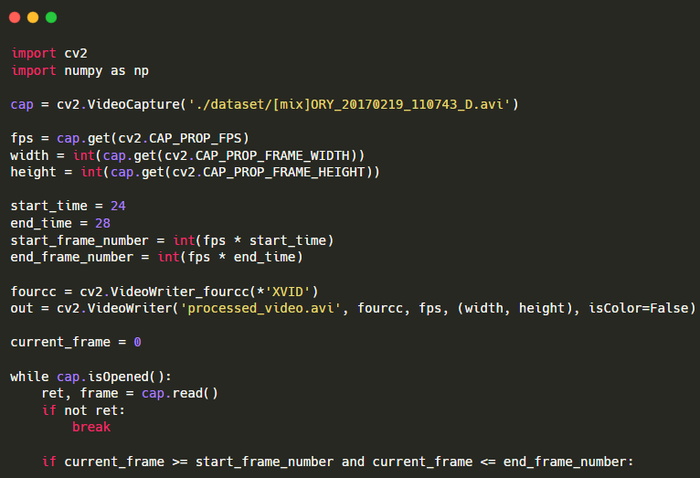
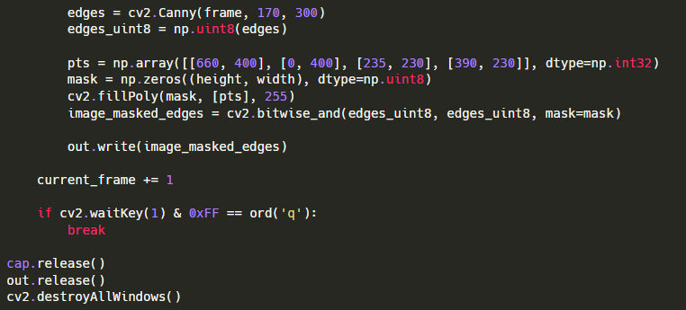
2. Edge – 2.2 Code
Lane Detection using color, edge, and straight line detection

Slide 21
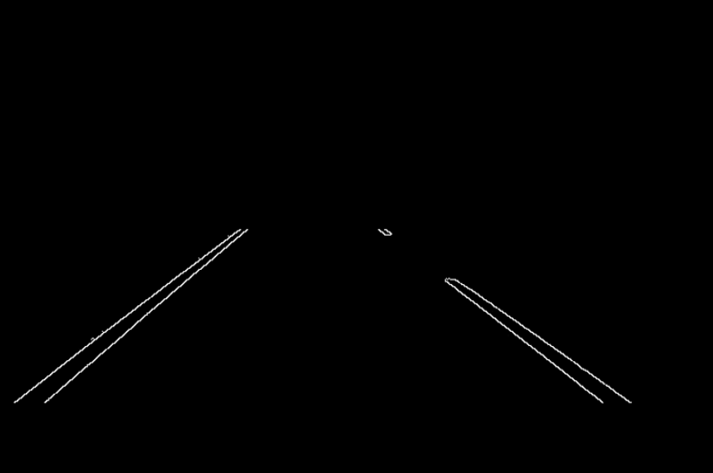
2. Edge – 2.3 Result
Lane Detection using color, edge, and straight line detection

Slide 22
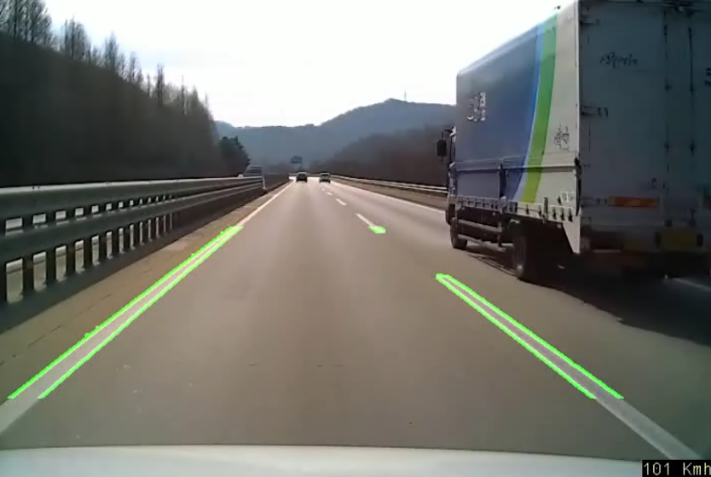
2. Edge – 2.3 Result
Lane Detection using color, edge, and straight line detection

Slide 23
3. Straight line detection
3.1 Hough Transform
3.2 Code
3.3 Result
3.4 Problem
3.5 Ransac
3.6 Code
3.7 Result
3.8 Problem

Slide 24
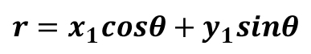


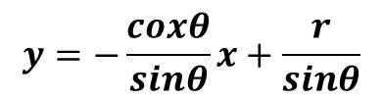


3. Staraight line detection – 3.1 Hough Transform
Lane Detection using color, edge, and straight line detection
< Line Detection >
1. Hough Transform
x
x
$$θ$$
$$(x_{1},y_{1})$$
$$(θ,r)$$
y
r
$$y=−\frac{coxθ}{sinθ}x+\frac{r}{sinθ}$$
$$r=x_{1}cosθ+y_{1}sinθ$$
$θ$ : 0 ~ 180
y

Slide 25
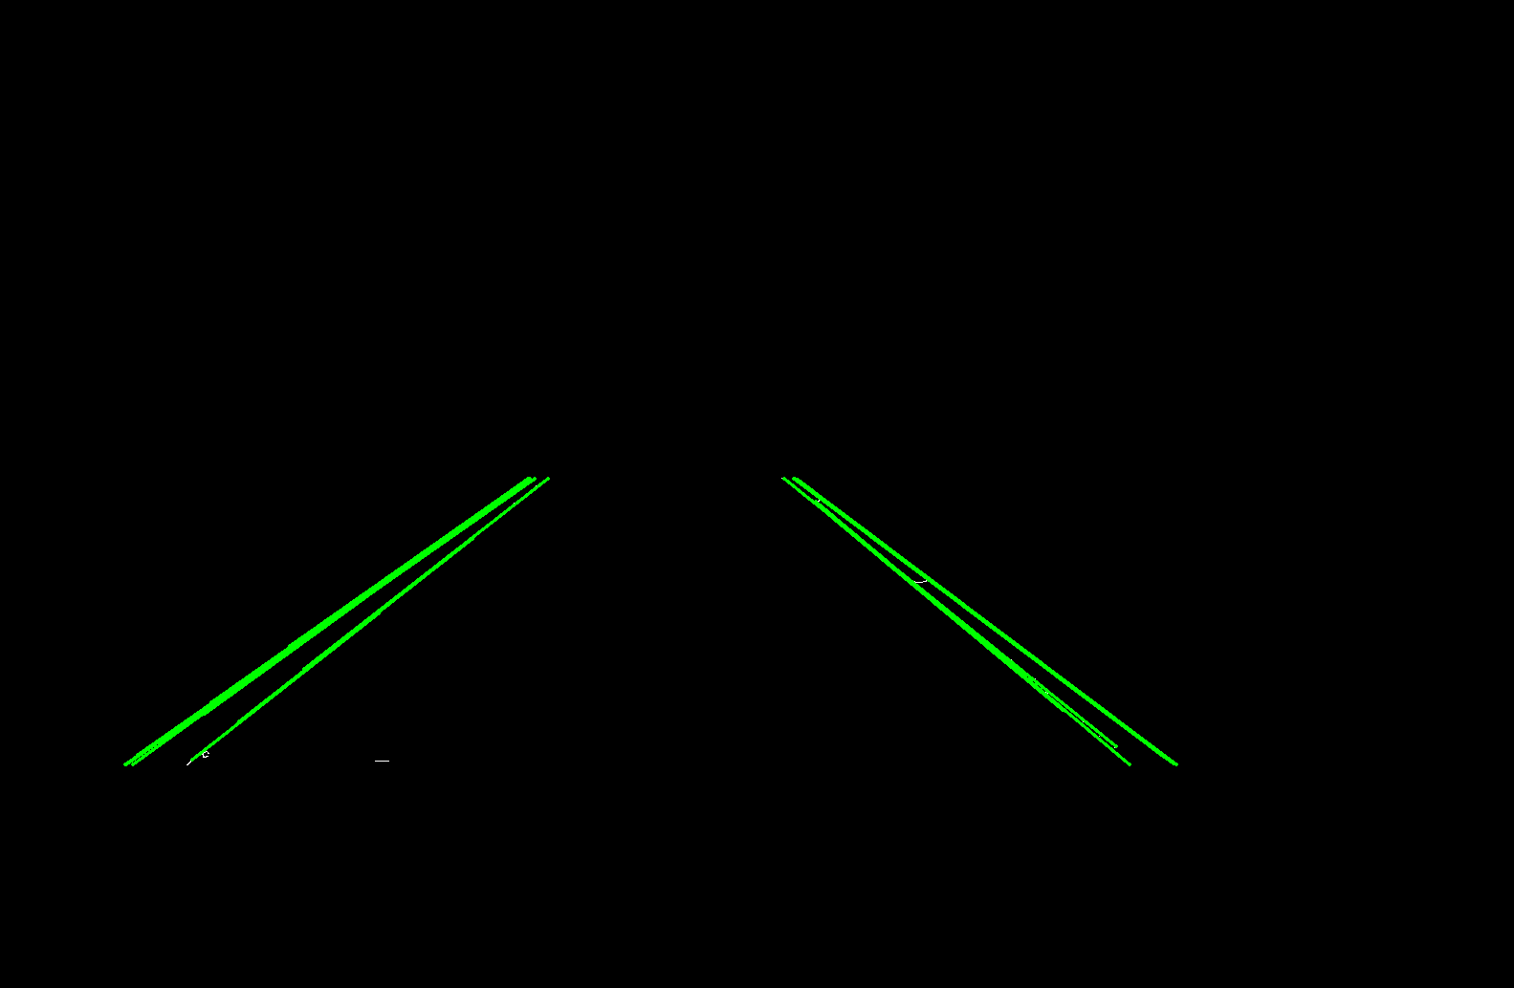
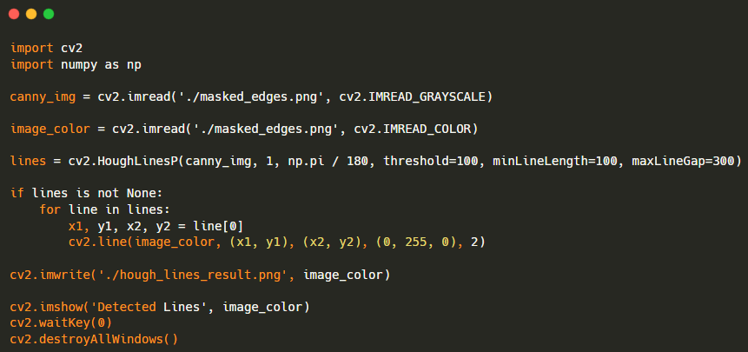
3. Staraight line detection – 3.2 Code
Lane Detection using color, edge, and straight line detection

Slide 26
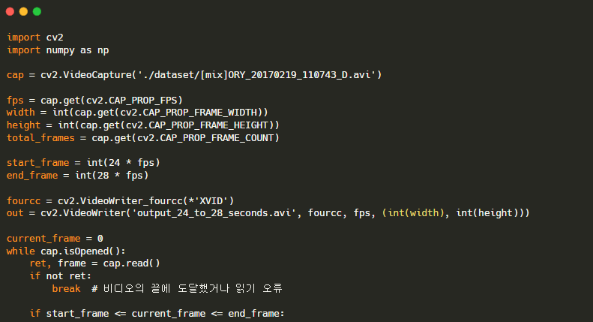
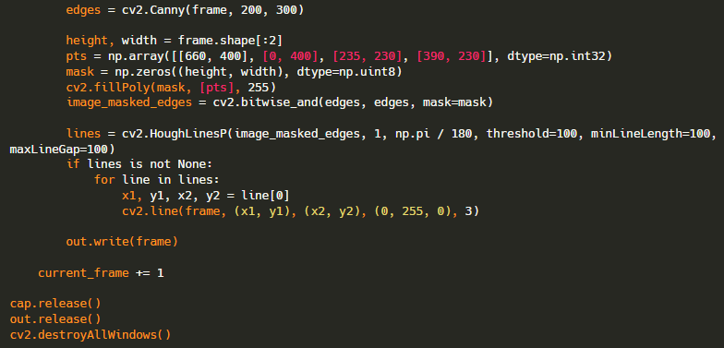
3. Staraight line detection – 3.2 Code
Lane Detection using color, edge, and straight line detection

Slide 27
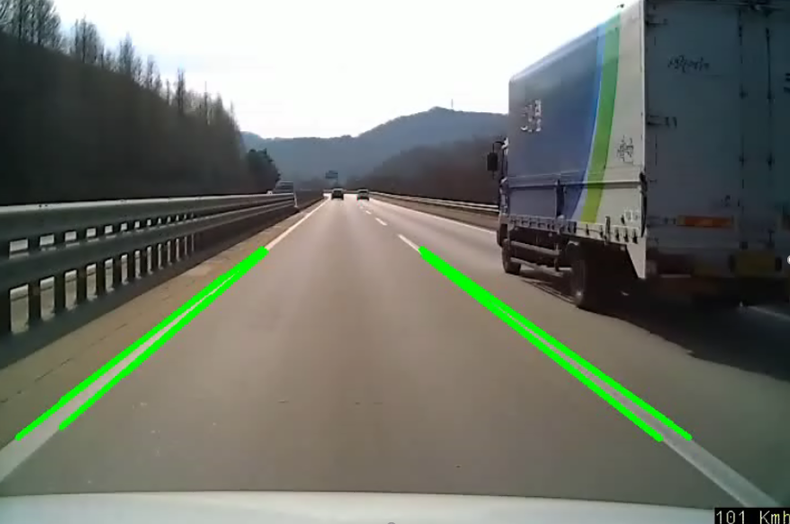
3. Staraight line detection – 3.3 Result
Lane Detection using color, edge, and straight line detection

Slide 28
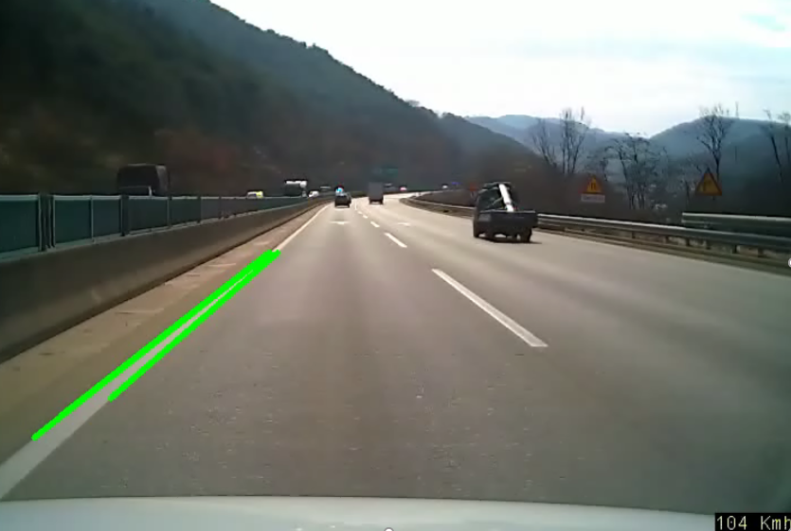
3. Staraight line detection – 3.3 Result
Lane Detection using color, edge, and straight line detection

Slide 29
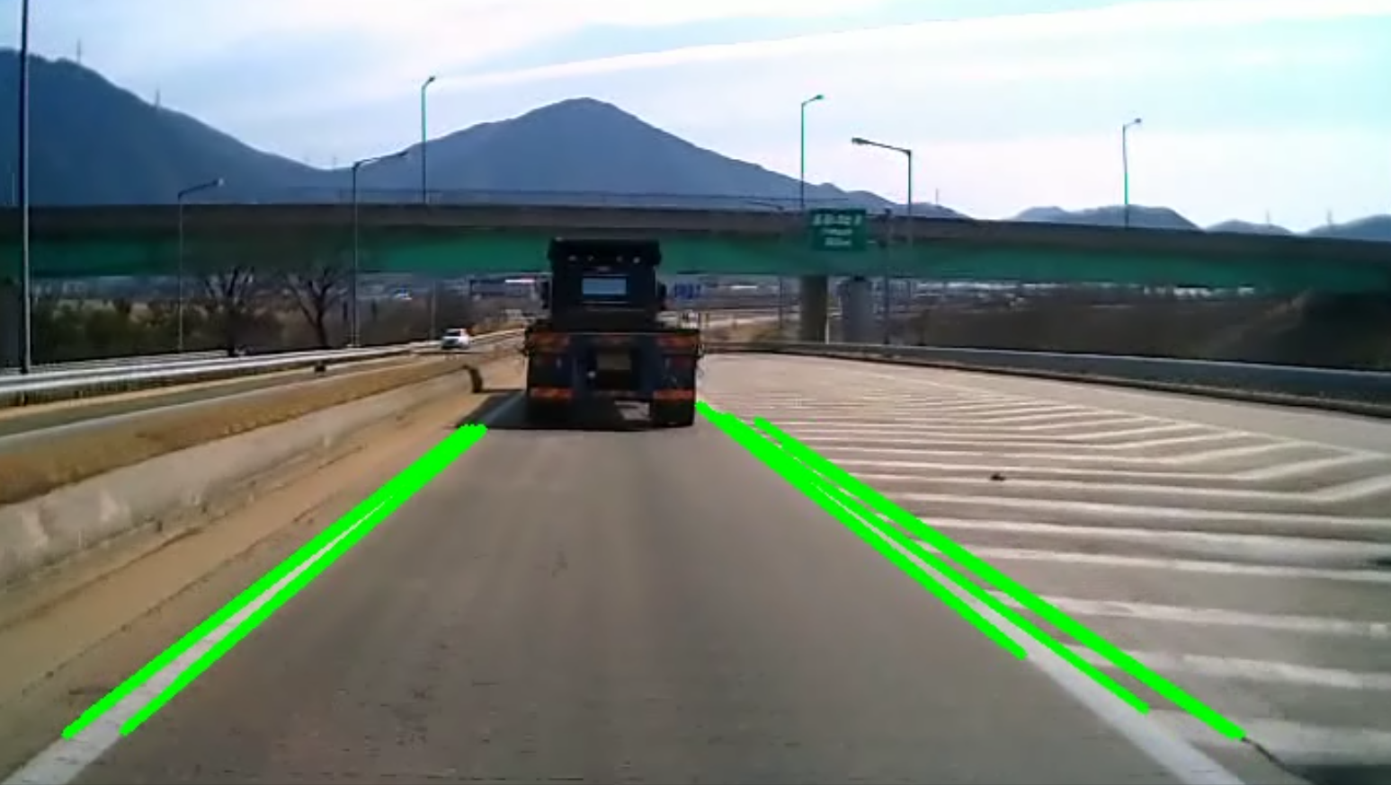
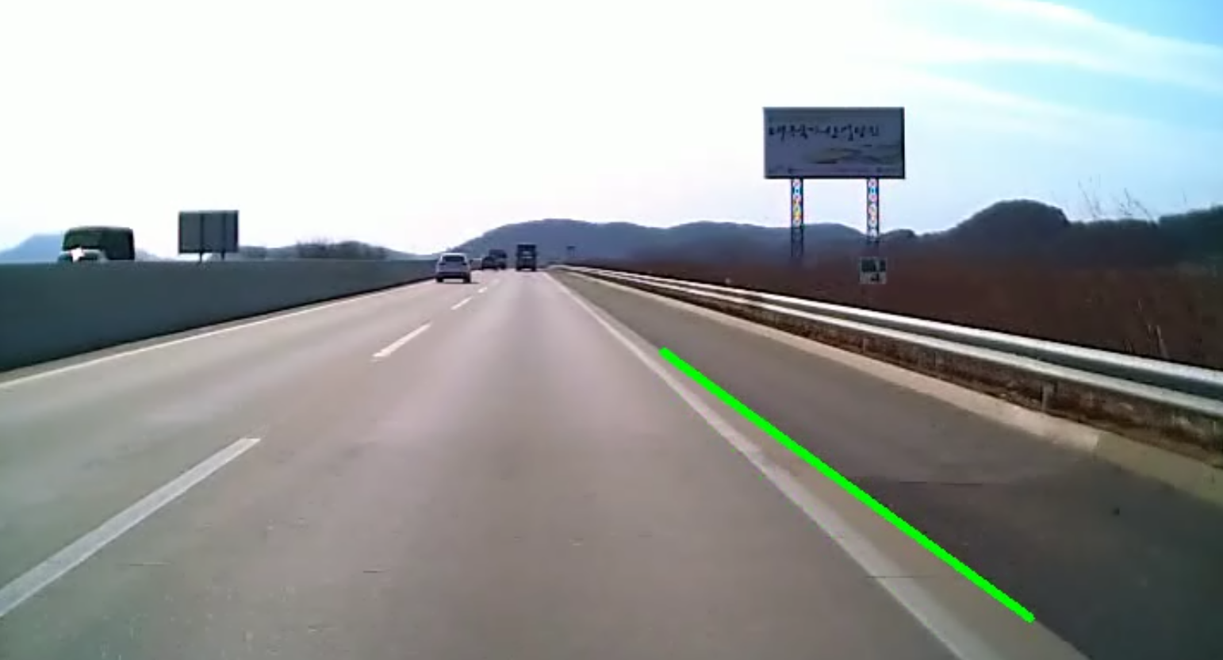
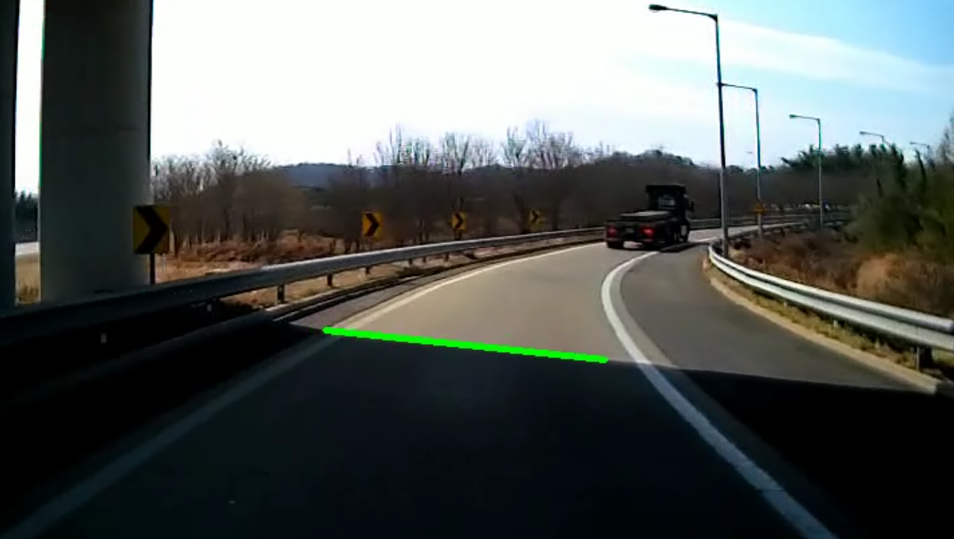
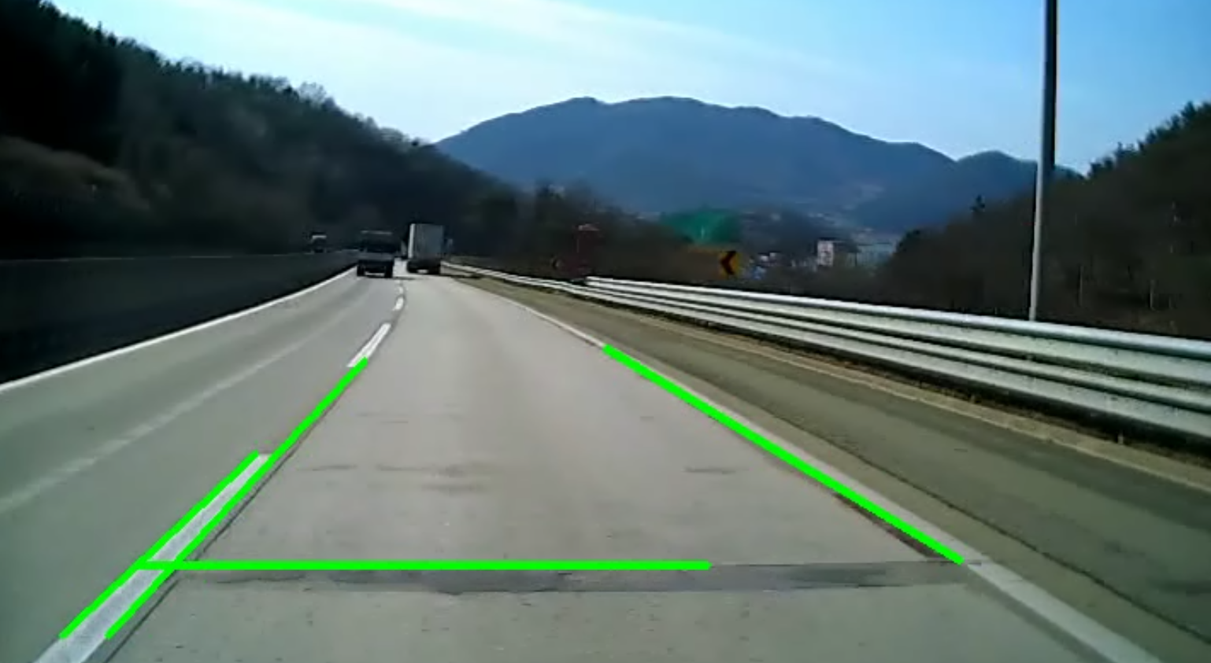
3. Staraight line detection – 3.4 Problem
Lane Detection using color, edge, and straight line detection
08:34
07:19
08:01
05:29

Slide 30
3. Staraight line detection – 3.5 Ransac
Lane Detection using color, edge, and straight line detection
< Line Detection >
2. Ransac(Random Sample Consensus)
t
t
t
t

Slide 31
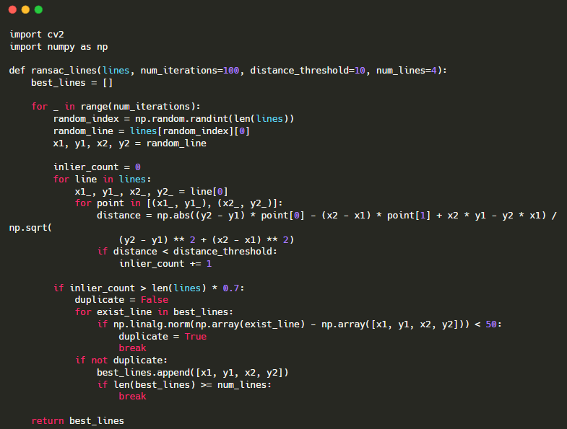
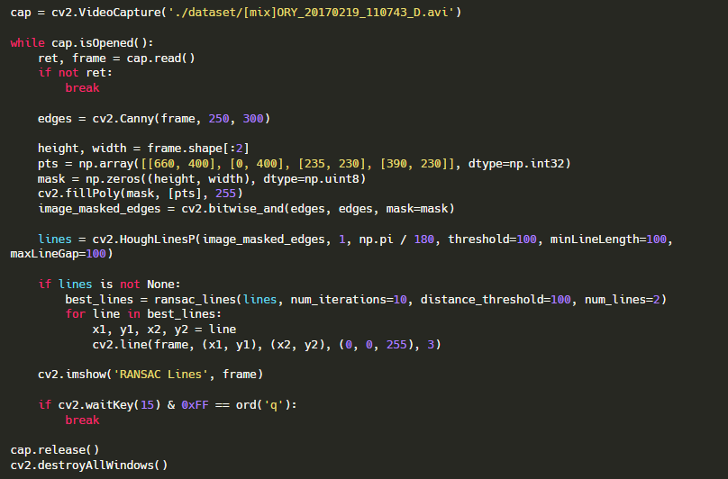
3. Staraight line detection – 3.6 Code
Lane Detection using color, edge, and straight line detection

Slide 32
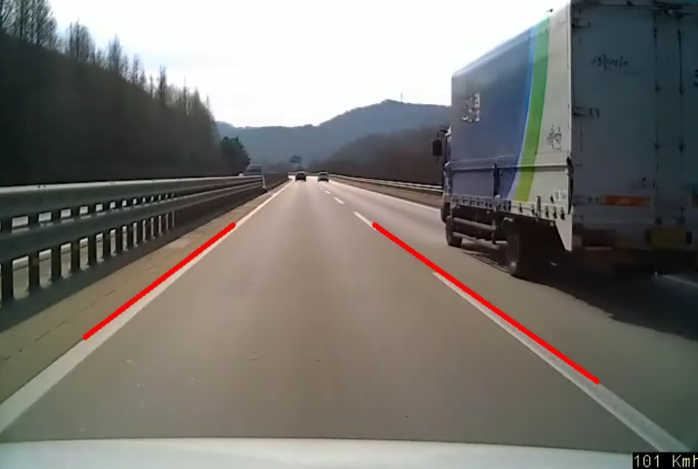
3. Staraight line detection – 3.7 Result
Lane Detection using color, edge, and straight line detection

Slide 33


3. Staraight line detection – 3.8 Problem
Lane Detection using color, edge, and straight line detection
08:34
08:34
05:29
05:29

Slide 34
Q n A

